Slide 1
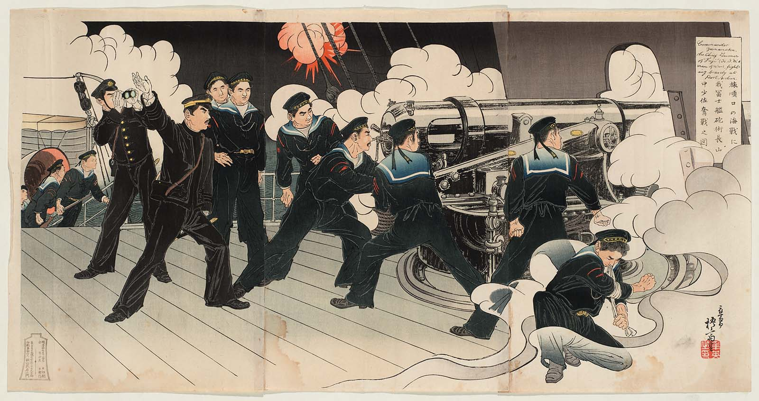
Historical Naval Fiction in the Age of Fighting Steam
1882: Britannia’s Spartan

